Slide 1


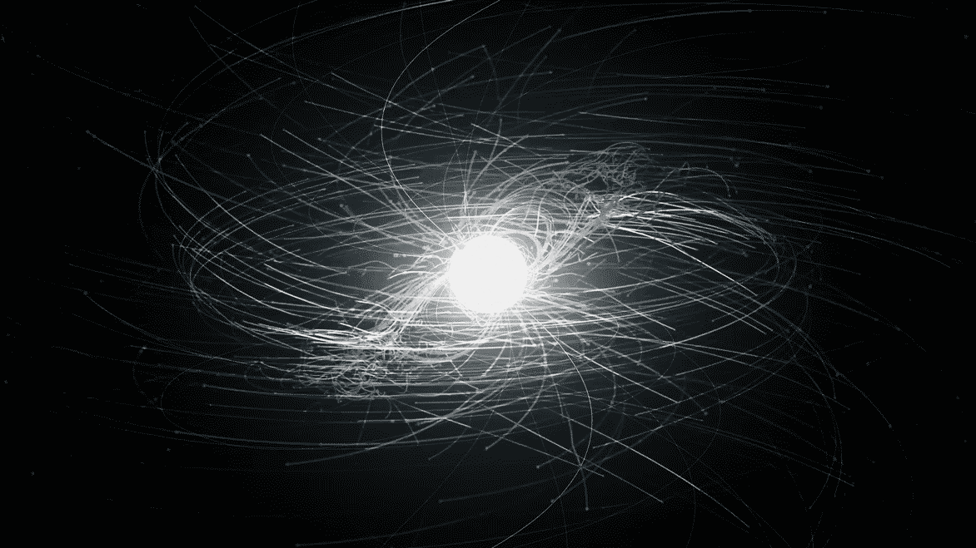
Stability of Magnetic Compact Stars
CFI Project Review 2021-22

Slide 2
Introduction
Neutron stars have always been a subject of keen interest to physicists. Magnetic field of these enigmatic stellar remnants are among the highest observed in the universe.
Such strong fields generated via experiments tend to be confined to small spaces, are highly unstable and decay quickly.
Neutron stars and White Dwarfs are known to hold their large fields for very long periods and sustain their stability.The Neutron Stars and White Dwarfs observed thus far are not known to have fields higher than 10¹⁵ Gauss.

Slide 3
Aim
To simulate Neutron stars using XNS code and Python libraries to try and answer these broad questions:
Is there an upper cap to the magnetic fields neutron stars can handle?
How does the stability of such stars behave at very strong fields?

Slide 4
Contents
This project was approached in a multifaceted way as the areas to work on were quite broad. We divided the work amongst three teams. Their results will be merged to answer the primary questions of this project.
Numerical solutions of the TOV equation The solutions to these equations provide us a glimpse into the background behind the XNS code.
XNS code
Dataset analysis of AXPs/SGRs Analysis on the properties of Anomalous X-ray Pulsars (AXPs) and Soft Gamma-ray Repeaters (SGRs)

Slide 5
Degeneracy Pressure
A pressure exerted by dense material consisting of fermions (such as electrons in a white dwarf star).
This pressure is explained in terms of the Pauli exclusion principle, which requires that no two fermions be in the same quantum state.
The more densely fermions are packed together and must share the same space, the more they must differ from each other in terms of their momentum.
In turn, the greater the range in momentum, the greater the fraction of particles with high momentum, and these exert pressure on their surroundings.

Slide 6
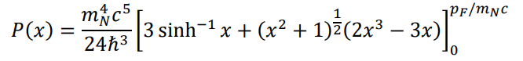
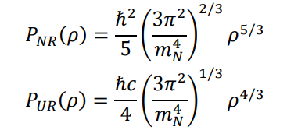
Theory of Equation of State
An equation of state (EoS) is a relation describing the state variables (pressure, temperature, density, etc.) of some system. In the case of our cold degenerate Fermi gas, we wish to find a relationship between the degeneracy pressure and mass/number density.
Non-relativistic case
Ultra-relativistic case

Slide 7
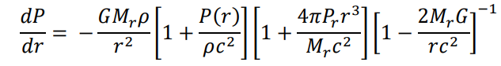
Tolman-Oppenheimer-Volkoff Equations
Previously we saw the degeneracy pressure for a cold Fermi gas composed of strictly neutrons.
However, another set of equations exists that describe the properties of stars; the stellar structure equations.
Together with the equations of state, we can study the characteristics of matter in a pure degenerate Fermi gas to a deeper level.

Slide 8
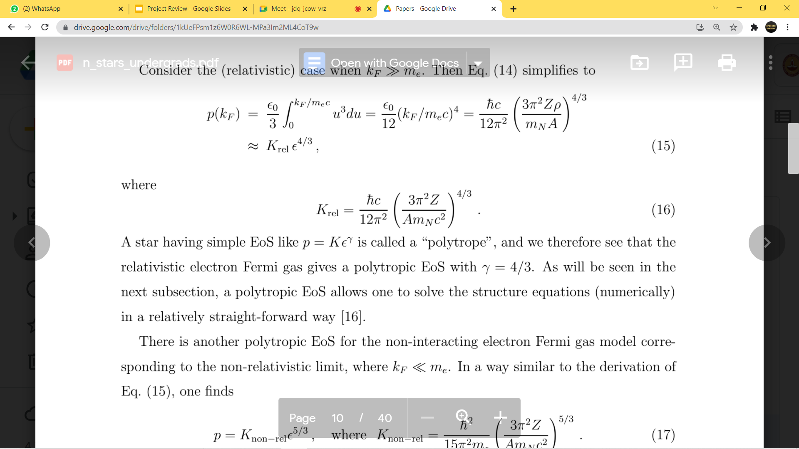
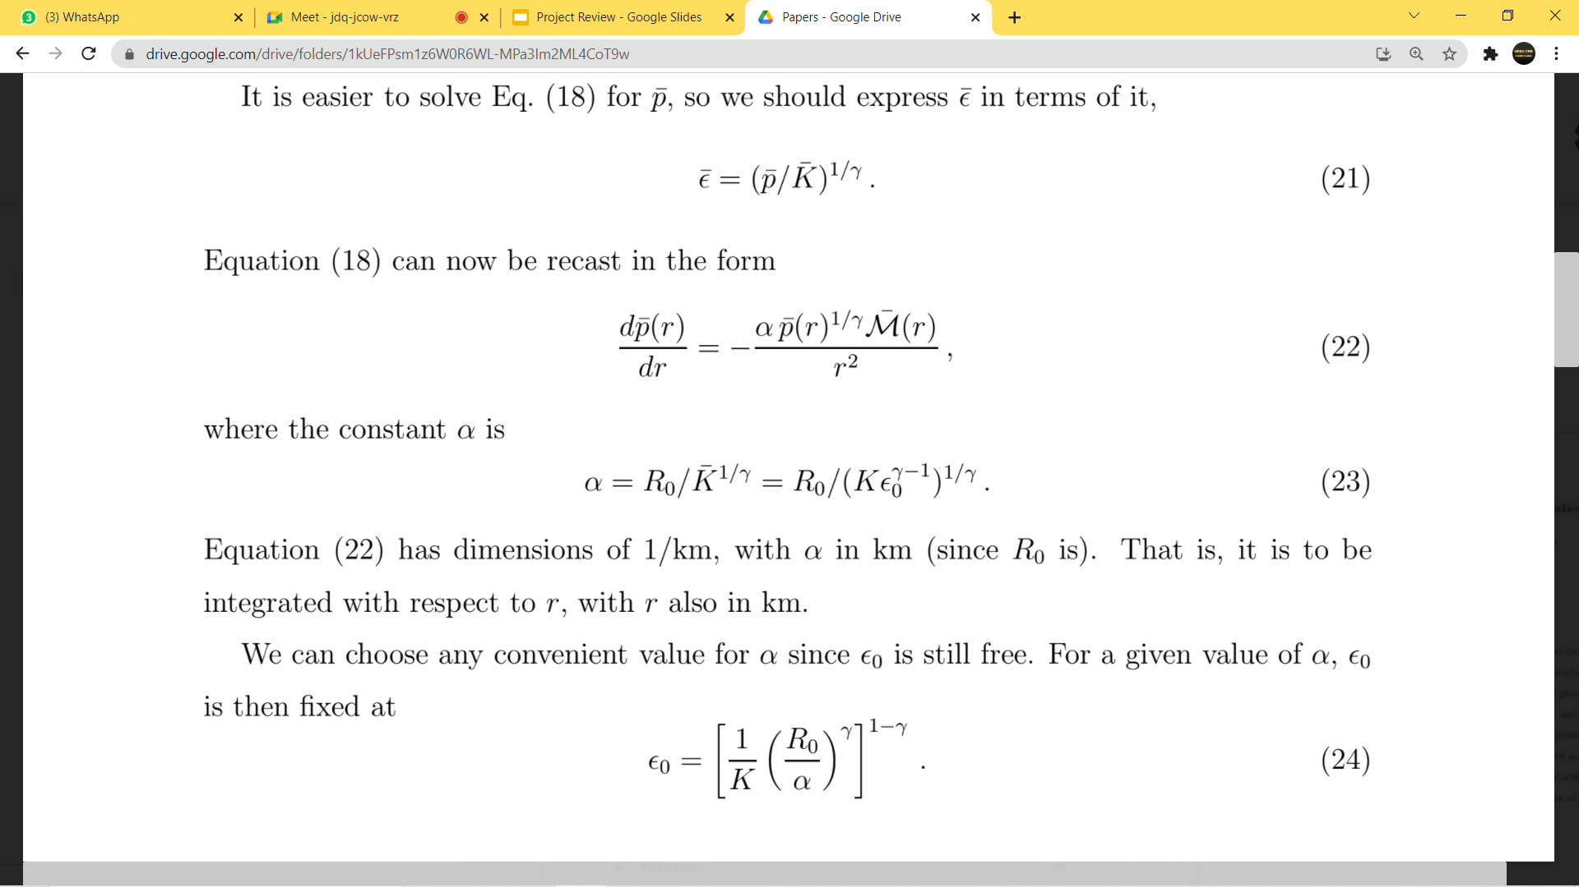
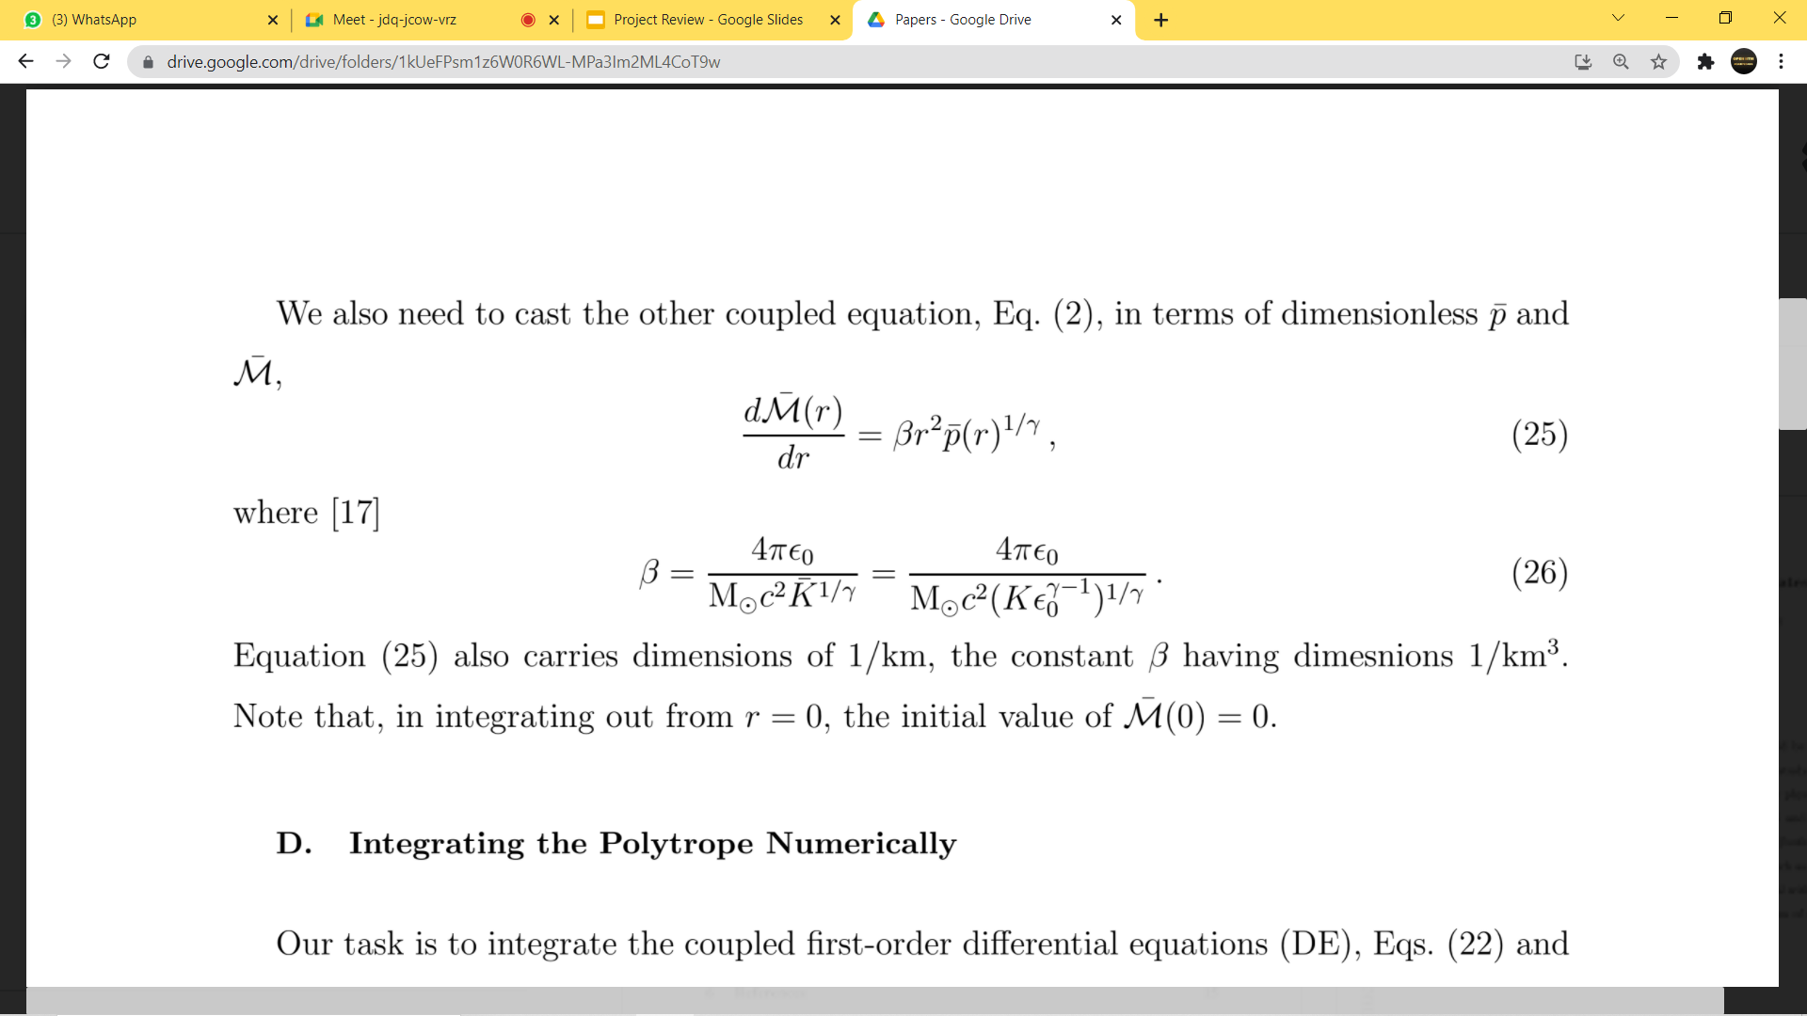
Work done in Equation of State simulation
Used the paper Neutron Stars for Undergraduates as the main reference.
First tried to get good idea about different models for white dwarfs and neutron stars.
Solved the coupled differential equation using Mathematica NDsolve function.
Reproduced some plots given in this paper using Mathematica
These two coupled differential equations are dimensionless, alpha, beta have unit ( 1/Km^2), energy density - epsilon,

Slide 9
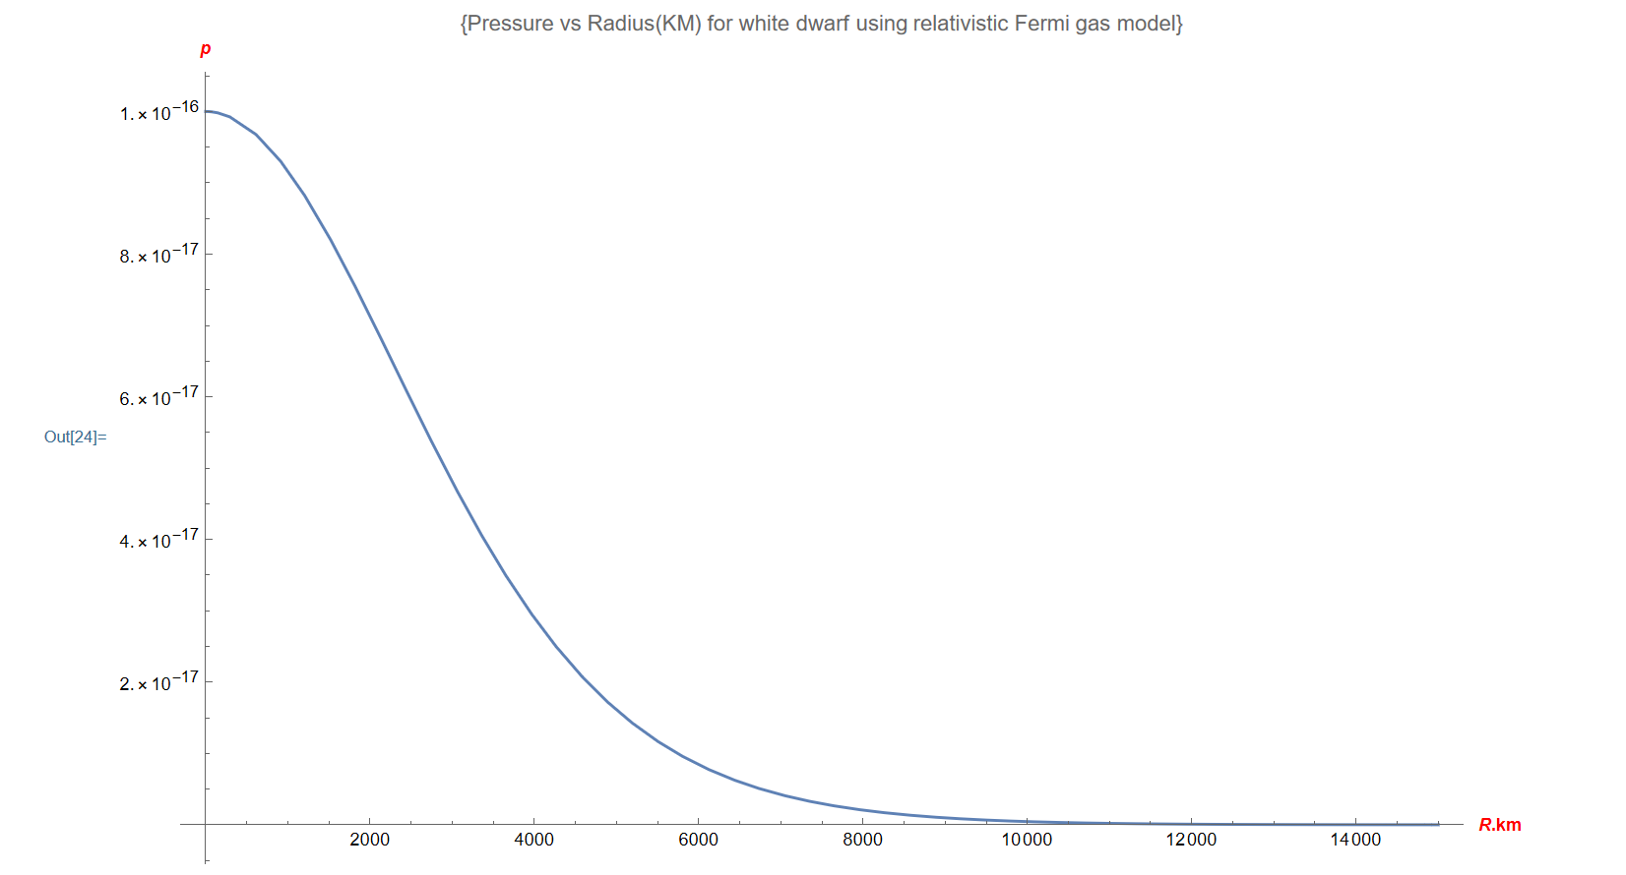
Pressure vs Radius(KM) for white dwarf using relativistic Fermi gas model

Slide 10
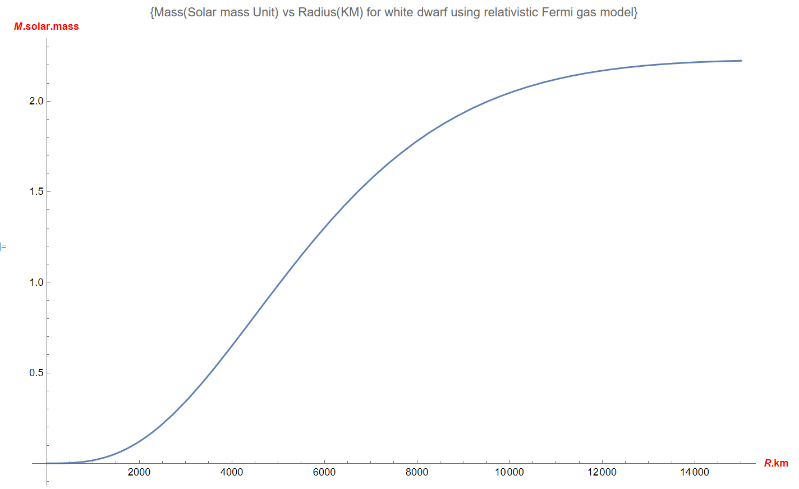
Mass vs Radius(KM) for white dwarf using relativistic Fermi gas model

Slide 11
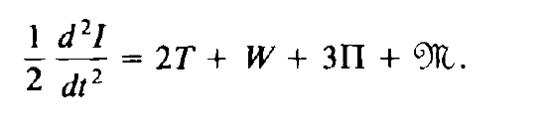
For the cases where the rotation or magnetic field of the neutron star or the white dwarf cannot be neglected, we need to apply the Virial equation.
This involves taking into account the various effects averaged over time. This equation was studied. We have it to be of the following form:
Where I is the moment of Inertia, T is the kinetic energy density, W is the gravitational potential energy, Pi is the overall pressure term, M is the magnetic field density. Using this we can model the cases which involve these terms, which could otherwise become difficult considering how complicated the equations of general relativity become.

Slide 12
Work done by the XNS group:
How we started
In order to simulate neutron stars using XNS code, XNS software was downloaded using the following link-
https://www.arcetri.inaf.it/science/ahead/XNS/download.html
(This works best with Linux OS)
Subsequent work
Before running the code, gfortran was installed in the Ubuntu environment. Thereafter, the XNS folder was copied into the system and, with the help of the code guide, ran the XNS code. On running the code, certain output quantities are displayed pertaining to the neutron star (its mass, energy and radius for instance).
After getting acquainted with the software, began varying specific parameters and looked for patterns in the output, which could then be plot to give a graphical intuition of the effect of changing said parameters.
The code guide contained a few default configurations for neutron stars (eg. Rotating poloidal star, toroidal star, etc) which provided us with a foundation to begin varying specific parameters.

Slide 13
Results and Observations
On varying the different print options, it was found that the code’s run time decreased to a great extent if we removed certain processes like the CPU steps from being displayed.
Changes in the parameters induced a change in the output i.e. the properties of the neutron star displayed.
Then tabulated these readings for different values of each parameter and then showed the variation by making plots using python.
It was found that varying certain parameters had a greater effect on the output than certain other parameters.

Slide 14
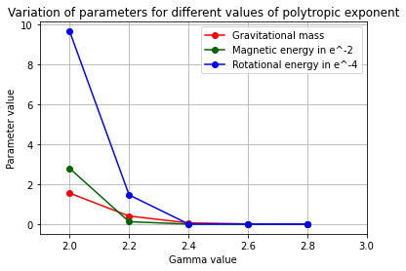
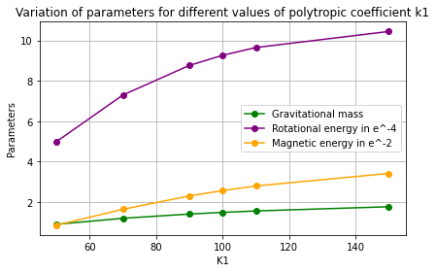
Plots:

Slide 15
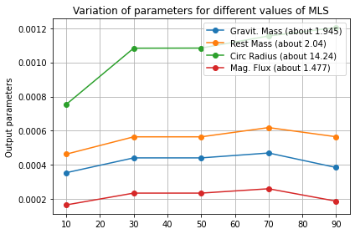
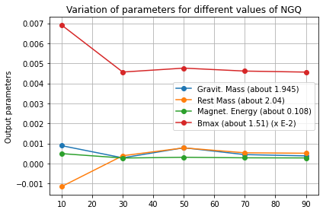

Slide 16
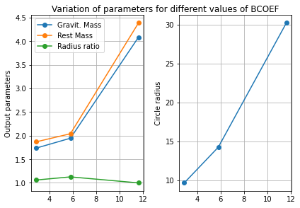
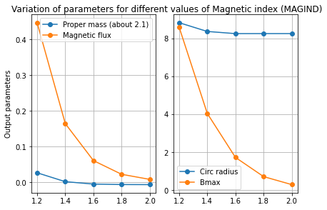

Slide 17
Work Done on AXPs/SGRs
Started by trying to have an understanding about Anomalous X-ray Pulsars (AXPs) and Soft Gamma-ray Repeaters (SGRs) and their properties.
The first research paper used for reference; ‘Soft gamma-ray repeaters and X-ray pulsars as highly magnetized white dwarfs’ by Banibrata Mukhopadhyay and A. R. Rao (https://arxiv.org/pdf/1603.00575.pdf) deals with the possibility of AXPs and SGRs being powered by highly magnetized white dwarfs.
Went through the paper to obtain various mathematical relations between properties of these ‘magnetars’ including energy of rotation, mass and time period. These equations can be used to plot relevant graphs so that these theoretical plots can be compared with corresponding ones from observed properties of known magnetars.

Slide 18
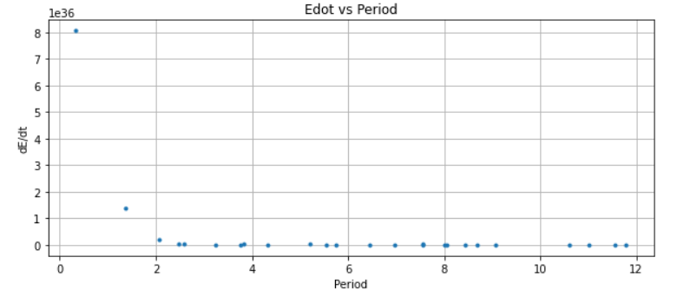
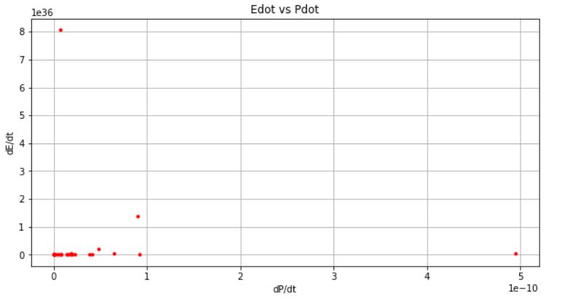
Plots
Data from McGill Online Magnetar Catalog -- Main Table of 30 Magnetars: 16 SGRs and 14 AXPs.
The data reflect the magnetars' persistent characteristics, rather than those observed during flare/burst periods.

Slide 19
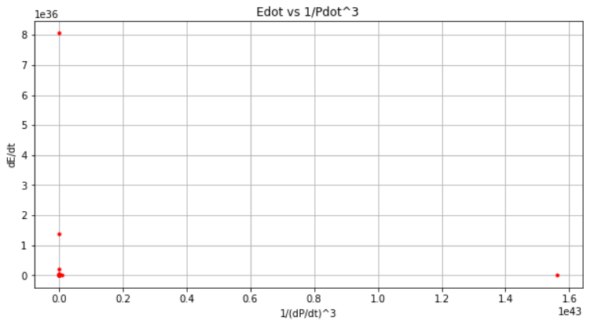
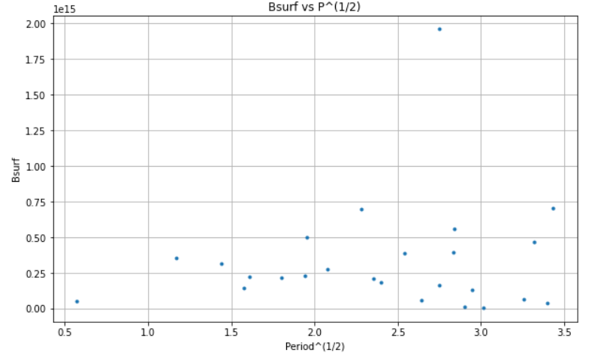
Where E is Energy in ergs, P is Time Period in sec, t is Time in sec and B_{surf} is Surface Magnetic Field in Gauss

Slide 20
Conclusions on AXPs/SGRs
The plots obtained from Magnetar catalog data are not consistent with the theoretical relations predicted in the research paper by Banibrata Mukhopadhyay and A. R. Rao used for reference (https://arxiv.org/pdf/1603.00575.pdf).
Thus, the hypothesis that AXPs and SGRs are highly magnetized white dwarfs doesn’t seem feasible.

Slide 21
Potential for Further Exploration
There is scope to analyse other possibilities such as described in following papers:
Paper that suggests AXPs and SGRs are linked with the remnants of supernova, and in turn also gives some contrast between AXPs and SGRs. ( https://arxiv.org/abs/1307.5391 )
Paper that suggests AXPs and SGRs arise from high mass X-ray binaries (neutron star with massive OB supergiant companion). ( https://arxiv.org/abs/1307.5391 )
Paper that compares AXPs and SGRs with X-ray dim isolated neutron stars (XDINs) (https://arxiv.org/abs/1601.07846 )

